Slide 1
Regression
CS3300 Data Science
RJ Nowling

Slide 2
Readings
Section 9.0-9.5

Slide 3
Common Forms of Machine Learning
Supervised Learning
Regression – predicting a continuous output
Classification – predicting a categorical output
Unsupervised Learning
Clustering – grouping similar records

Slide 4
Define a Problem
We want to predict the sale price for real estate transactions. Regression
We want to predict whether the animal in a picture is a cat or dog. Classification

Slide 5
Terminology
Response – output variable we are trying to predict
Predictor – input variable we are using to predict the response

Slide 6
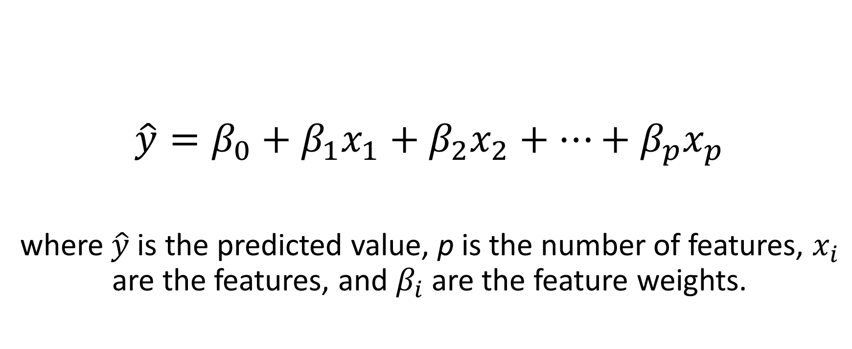
(Multiple) Linear Regression
$$\hat{y}=β_{0}+β_{1}x_{1}+β_{2}x_{2}+⋯+β_{p}x_{p}$$
where $\hat{y}$ is the predicted value, p is the number of features, $x_{i}$ are the features, and $β_{i}$ are the feature weights.

Slide 7
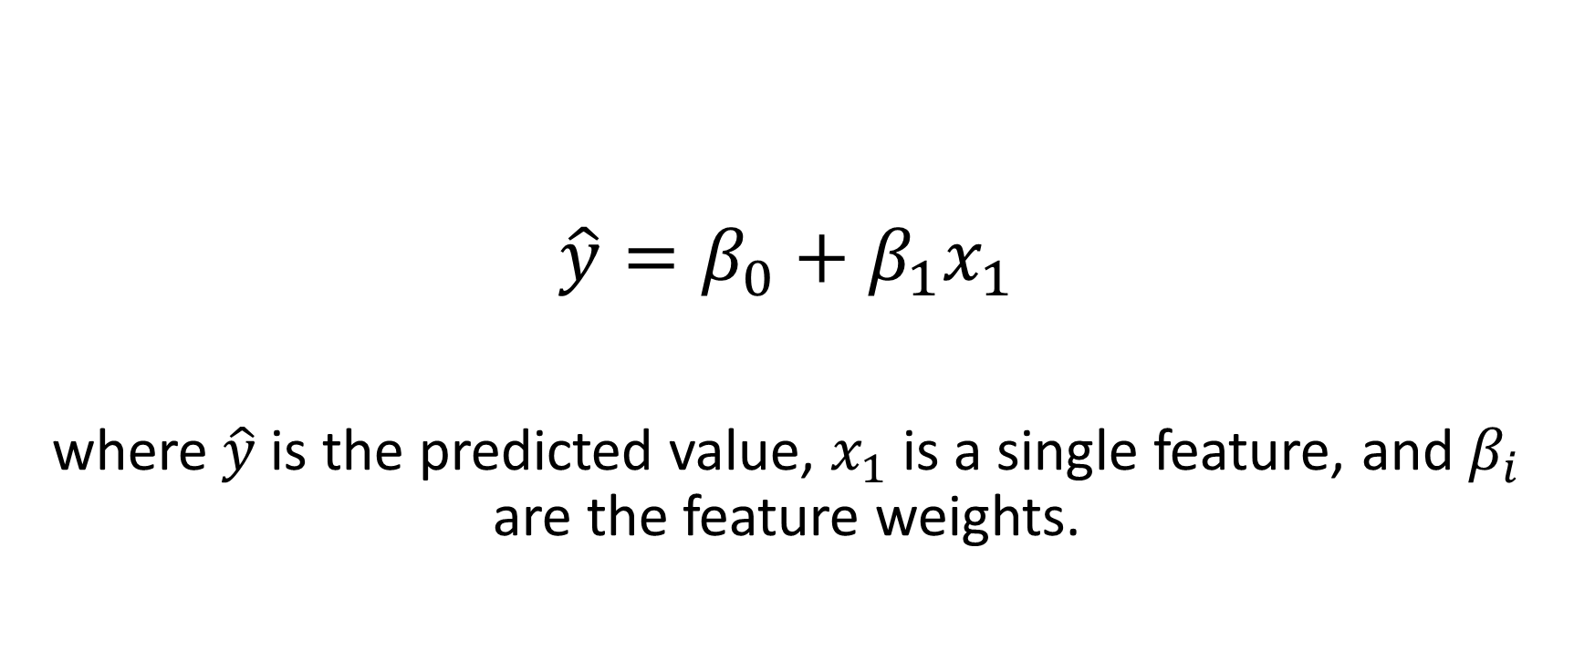
Simple Linear Regression
$$\hat{y}=β_{0}+β_{1}x_{1}$$
where $\hat{y}$ is the predicted value, $x_{1}$ is a single feature, and $β_{i}$ are the feature weights.

Slide 8
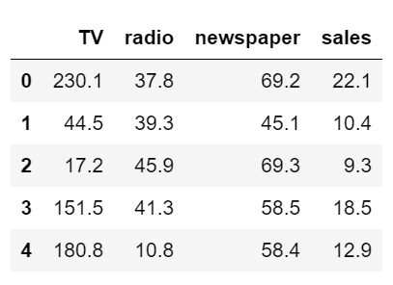
Advertising Data Set
Response: Sales
Predictors:
Amount of TV advertisements
Amount of radio advertisements
Amount of newspaper advertisements

Slide 9
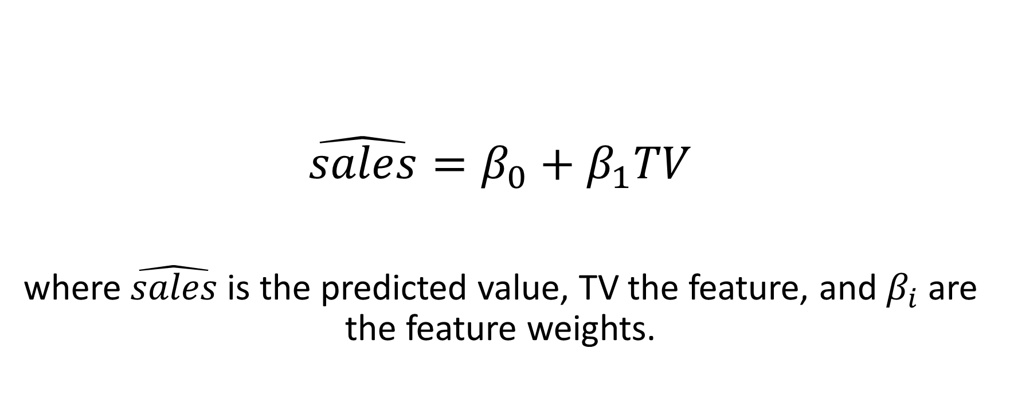
Advertising Data
$$\hat{sales}=β_{0}+β_{1}TV$$
where $\hat{sales}$ is the predicted value, TV the feature, and $β_{i}$ are the feature weights.

Slide 10

Fitted Model
$β_{0}=0.0818$ base units of sales
$β_{1}=0.3483$ units of sales per unit of TV advertisements over base

Slide 11
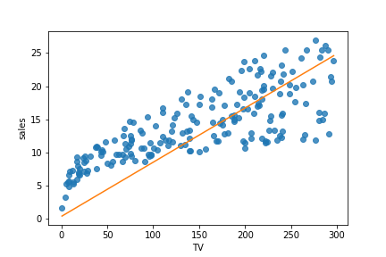
Plot of Linear Regression Model

Slide 12
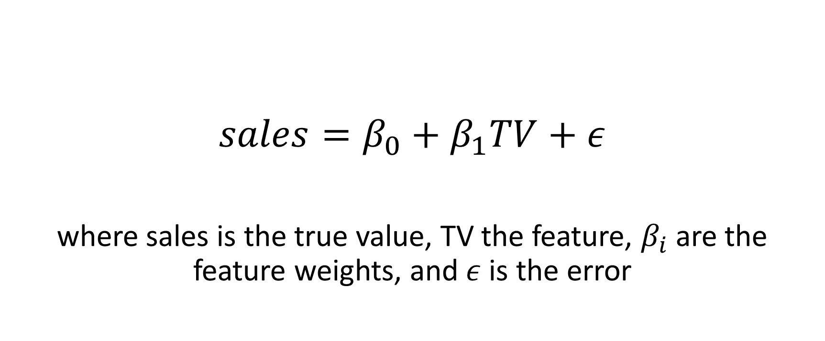
Advertising Data
$$sales=β_{0}+β_{1}TV+ε$$
where sales is the true value, TV the feature, $β_{i}$ are the feature weights, and $ε$ is the error

Slide 13
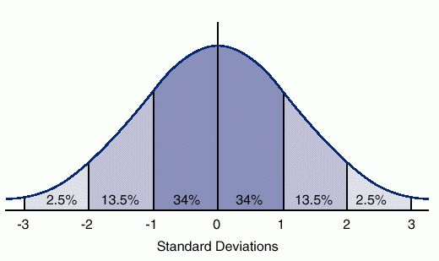
Assumed Error Distribution

Slide 14
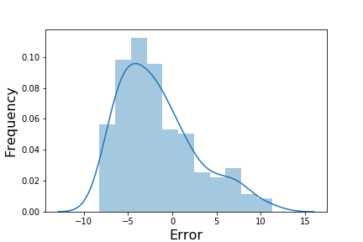
Error Distribution

Slide 15
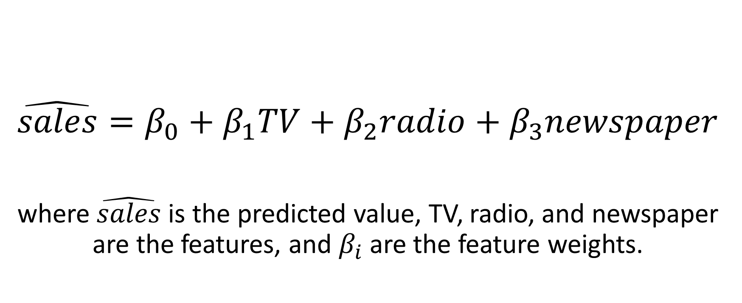
Advertising Data
$$\hat{sales}=β_{0}+β_{1}TV+β_{2}radio+β_{3}newspaper$$
where $\hat{sales}$ is the predicted value, TV, radio, and newspaper are the features, and $β_{i}$ are the feature weights.

Slide 16

Fitted Model
$β_{0}=0.0874$ base units of sales
$β_{1}=0.0530$ units of sales per unit of TV advertisements
$β_{2}=0.2215$ units of sales per unit of radio advertisements
$β_{3}=0.0162$ units of sales per unit of newspaper advertisements

Slide 17
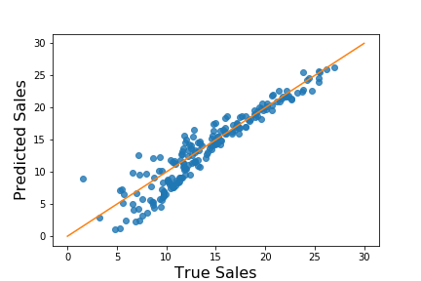
Predictions vs True Sales

Slide 18

Metrics for Evaluating Regression Models
Mean-Squared Error $MSE= \frac{1}{N}\sum_{i=1}^{N}{{(y−\hat{y})}^{2}}$
Root Mean-Squared Error $RMSE= \sqrt{\frac{1}{N}\sum_{i=1}^{N}{{(y−\hat{y})}^{2}}}$

Slide 19
Advertising Error
Mean-Squared Error: 3.981
Root Mean-Squared Error: 1.995

Slide 20
Linear Relationships
The response variable does not need to be linear for linear regression to work
The relationships between the response and predictors must be linear, however

Slide 21
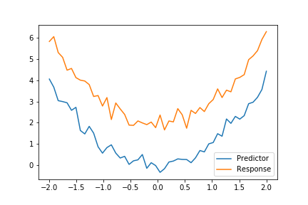
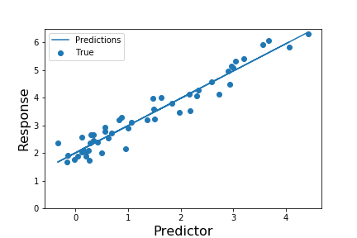
Non-Linear Data

Slide 22
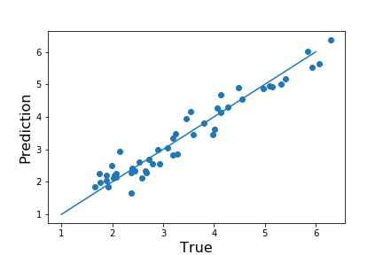
Non-Linear Data

Slide 23
Error
Mean-Squared Error: 0.114
Root Mean-Squared Error: 0.337

Slide 24
Credit Data Set
Response: Balance
Numerical Predictors:
Income, Limit, Ratings, Cards, Age, Education
Categorical Predictors:
Gender: Male, Female
Student: Yes, No
Married: Yes, No
Ethnicity: African-American, Caucasian, Asian

Slide 25
Categorical Variables
How do we interpret categories numerically?
We can't
We can use one-hot encoding to create a separate numerical variable for each category in a categorical variable
If there are N categories (e.g., is a student, is not a student), then we create N new "dummy" variables
We set one of the N dummy variables to 1, the rest to 0

Slide 26
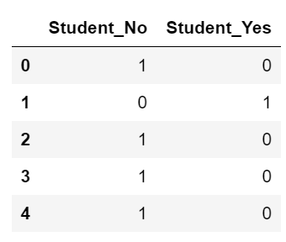
Credit Student Example

Slide 27
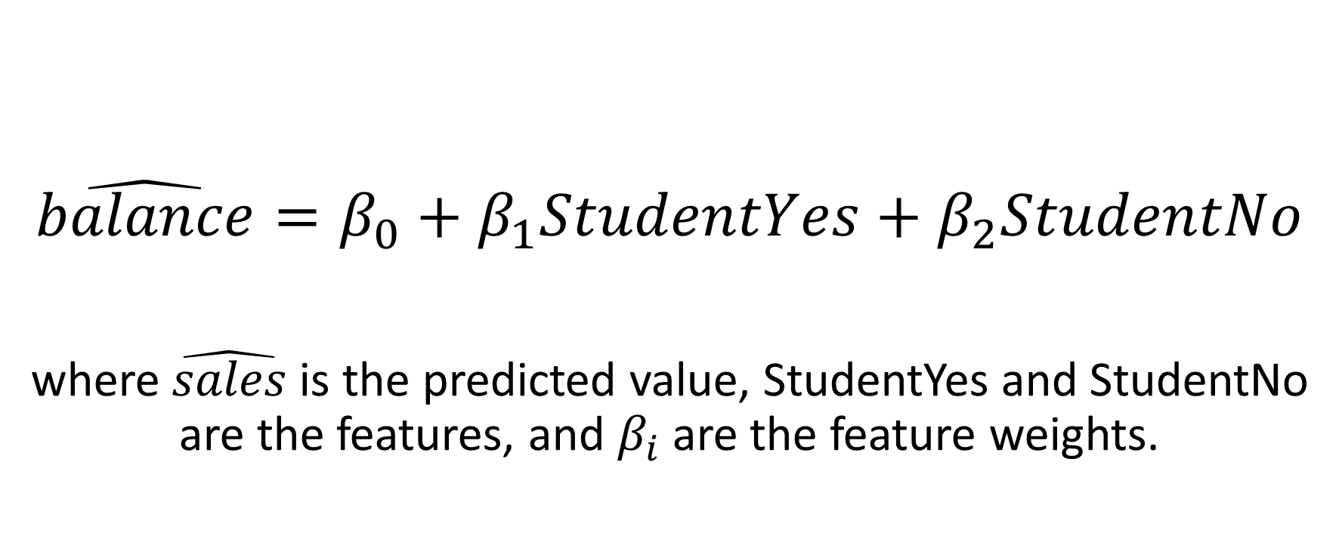
Credit Data
$$\hat{balance}=β_{0}+β_{1}StudentYes+β_{2}StudentNo$$
where $\hat{sales}$ is the predicted value, StudentYes and StudentNo are the features, and $β_{i}$ are the feature weights.

Slide 28
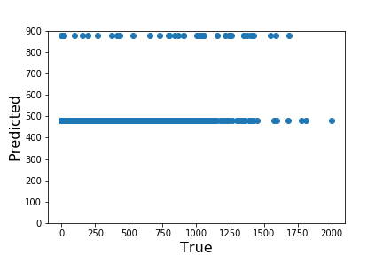
Credit Predictions
MSE: 196704.1
RMSE: 443.5

Slide 29
Regularization
Regularization involves adding a penalty term when fitting a model
The penalty term is based on the weights of the model

Slide 30
Lasso
The regularization term is based on the L2 norm of the weights
L2 regularization improves the model stability
E.g., helps the model handle collinear predictors
Default in Scikit Learn's SGDRegressor class

Slide 31
Ridge
The regularization term is based on the L1 norm of the weights
Enables the model to pick a subset of the predictors by setting the weights for unused features to 0

Slide 32
Other Regression Techniques
Polynomial regression
Multivariate adaptive regression splines (MARS) regression
Random Forest Regression
k-Nearest Neighbor (kNN) Regression

